Slide 1
German Unification
The question of how to unify the many small German states in the middle of Europe had been hotly debated for centuries. Following a series of sharp, short wars against Denmark, Austria, and France, Prussia unified the German states into one country in 1871. Unification put a large, powerful country on the map and made Germany an instant power. German leaders reacted differently to the countries they defeated in war. They treated Austria leniently, taking no Austrian territory and leaving open the possibility of an alliance in the future. They treated France much more harshly, making France pay an indemnity, meaning that France had to pay for Germany’s war expenses. The Germans also seized two French provinces, Alsace and Lorraine.

Slide 2
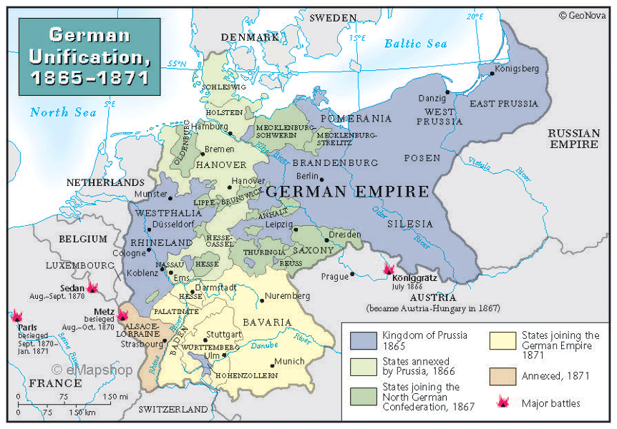
Unification and Allies
The new Germany was a federated country, meaning that it had a central government in Berlin, but local governments retained a lot of power, including their own armies. The new state had a large population, a strategic location, and a growing economy. It needed allies to secure at least some of its borders and good relations with all of its neighbors to ensure markets for its goods. Some Germans wanted overseas colonies, but others thought that Germany should focus on continental affairs.

Slide 3
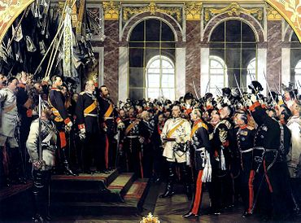
France and Germany's Relationship Status: Complicated
The new Germany was created in a ceremony at the Palace of Versailles outside Paris. Having the ceremony in the traditional residence of French kings hurt French pride and rubbed salt in the wounds of the French military defeat. Notably, the French insisted that the Germans sign the 1919 Treaty of Versailles in this same room, Versailles’ famous Hall of Mirrors.

Slide 4
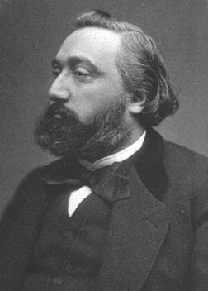
Leon Gambetta
Léon Gambetta was one of the best-known French politicians of his age. In 1871 he escaped from Paris, then under siege by the Germans, in a daring hot air balloon voyage. He urged Frenchmen to keep their defeat in their hearts, famously saying “Think of it always, speak of it never.” By 1914, however, the defeat, although still humiliating, had stopped motivating most Frenchmen. As one French student told a newspaper just before World War I began, “I do not think that this question interests the youth of today or the country, nor does it interest me.”

Slide 5
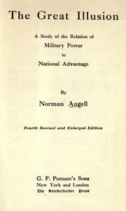
The Great Illusion
Norman Angell’s 1910 bestseller The Great Illusion argued that economics were more important than politics. Angell contended that even if two countries like France and Germany had a tense history and political goals in opposition to one another, their shared economic interests would keep them from going to war. His thesis led many Europeans to believe that the growing interconnectedness of the European and global economies would prevent trade partners (like France and Germany or Germany and Russia) from ever going to war.

Slide 6
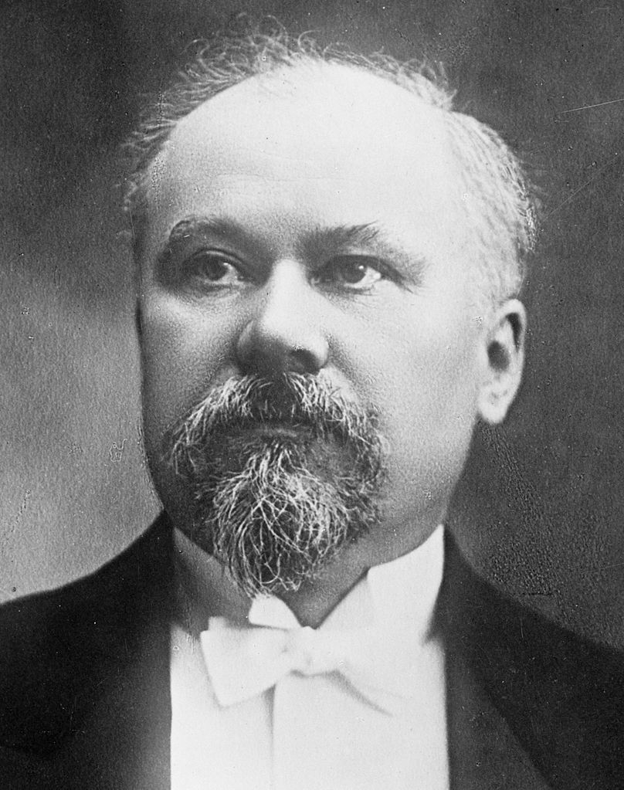
Taking a Stand
Raymond Poincaré was the president of France. He took a hard line against Germany in public and came from the “lost province” of Lorraine, seized by Germany from France in 1871. But at the same time, he worked hard to normalize relations between the two countries. In 1913 he became the first French president since 1871 to dine at the German embassy, a step that most people saw as a positive development in the relationship between the two countries.

